Slide 1
The TL system
INSTALL INSTRUCTIONS

Slide 2
http://faculty.ist.unomaha.edu/winter/ShiftLab/TL_web/TL_index.html

Slide 3
These slides will walk you through the following
Download the TL_System
This file needs to be unzipped and its contents placed in a location whose path contains no spaces.
Download the Bascinet B4 IDE
This file needs to be unzipped and its contents placed at a location of your choice.
Download and install Mlton.
Configure the B4 IDE.
Point B4 to the TL_System folder.
Point B4 to the MLton folder.
Build the parser and transformation components associated with a domain.
Apply a selected transformation to a selected target program.

Slide 4
File downloads
The TL_System, B4 and Mlton

Slide 5
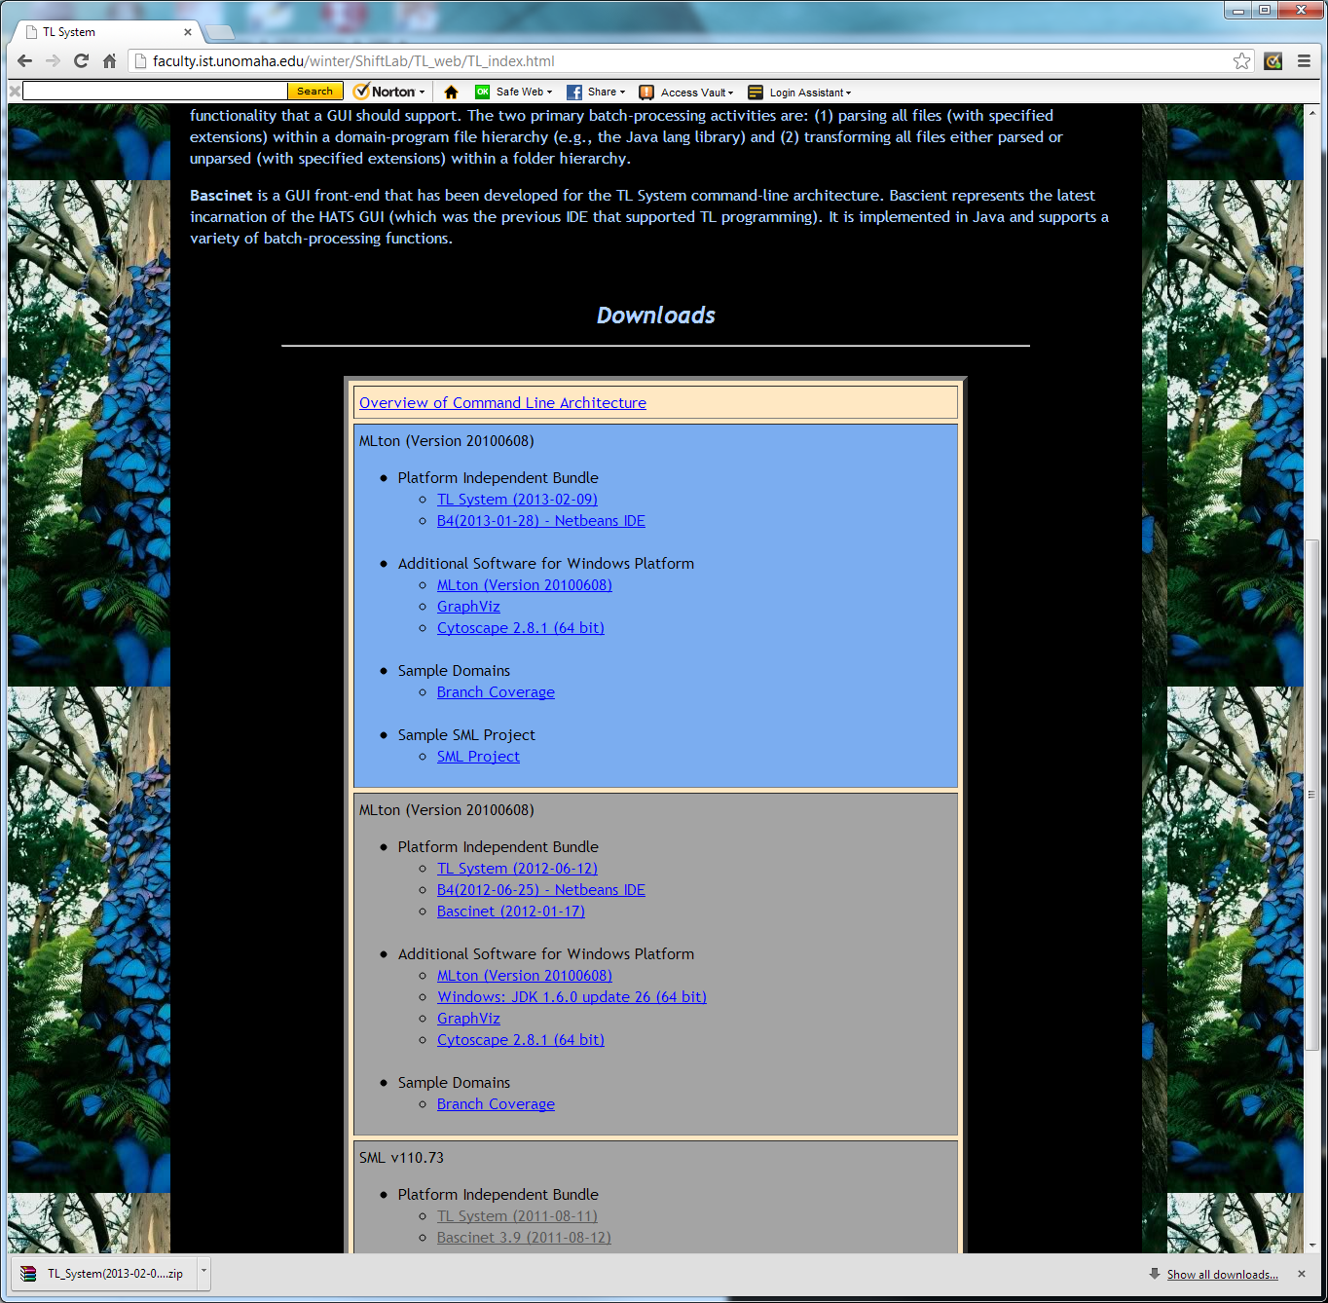
Left mouse click

Slide 6
This file is placed in your “Downloads” folder.

Slide 7

Left mouse click

Slide 8
This file is placed in your “Downloads” folder.

Slide 9

Left mouse click

Slide 10
This file is placed in your “Downloads” folder.

Slide 11
Configuration
Connecting the TL System, B4 and Mlton

Slide 12
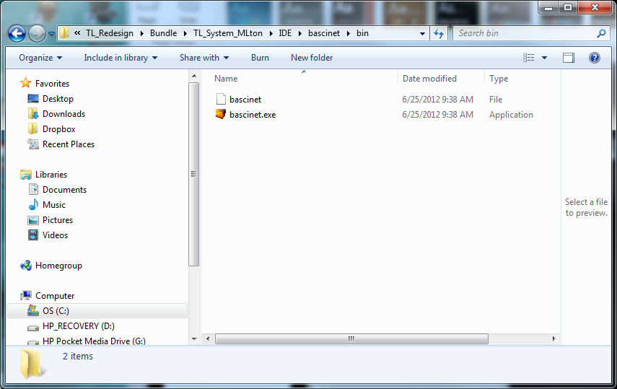
Left mouse double-click

Slide 13
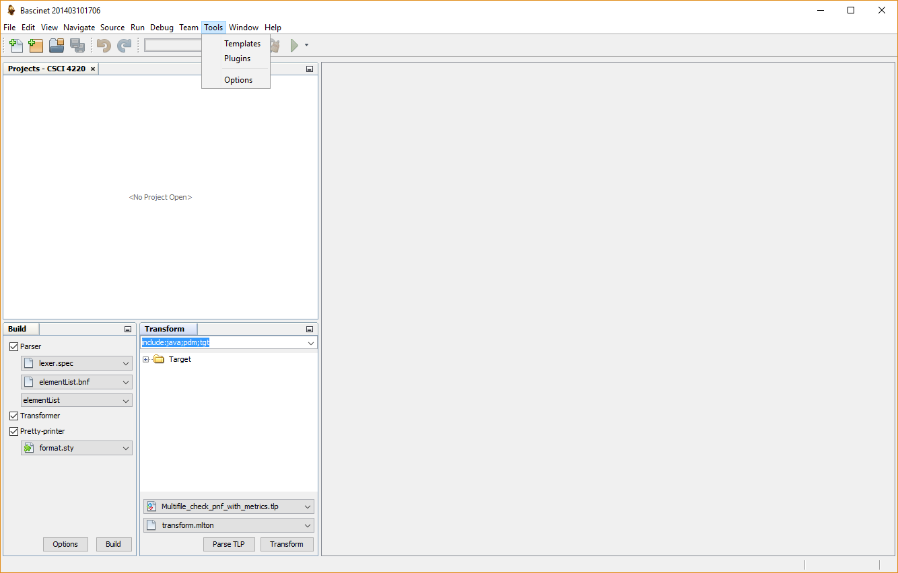
Select Options from the dropdown menu

Slide 14
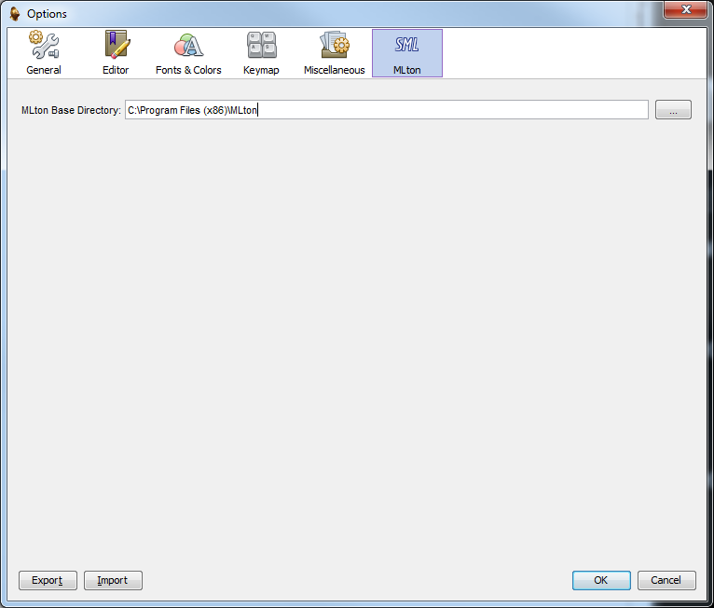
Navigate to where MLton is installed on your system
Browse the file directory

Slide 16
Domains
Opening a project (aka domain) and linking it to the TL System

Slide 17
A domain is a folder that may be placed in any location whose path contains no spaces.

Slide 18
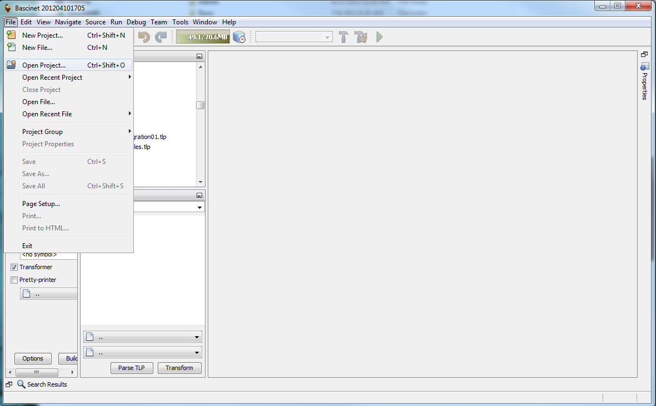
Select Open Project from the drop-down menu

Slide 19
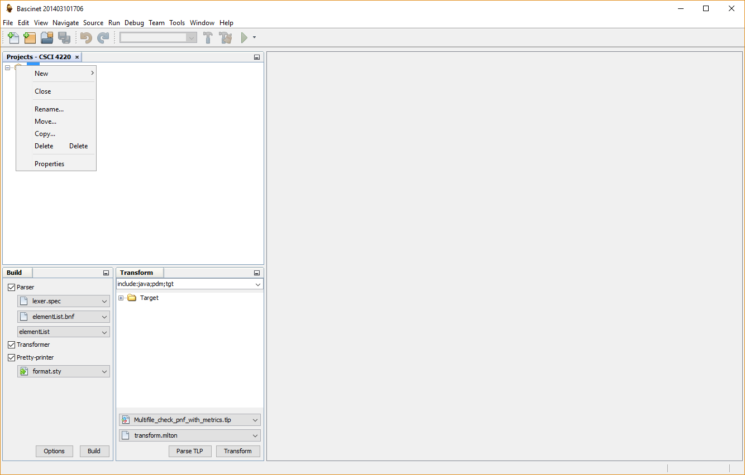
Select Properties from the drop-down menu

Slide 20
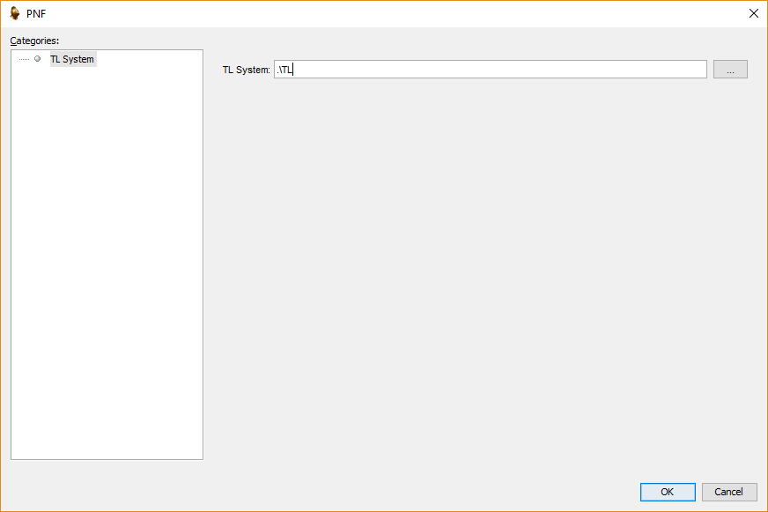
Browse the file directory for the TL_System folder

Slide 21
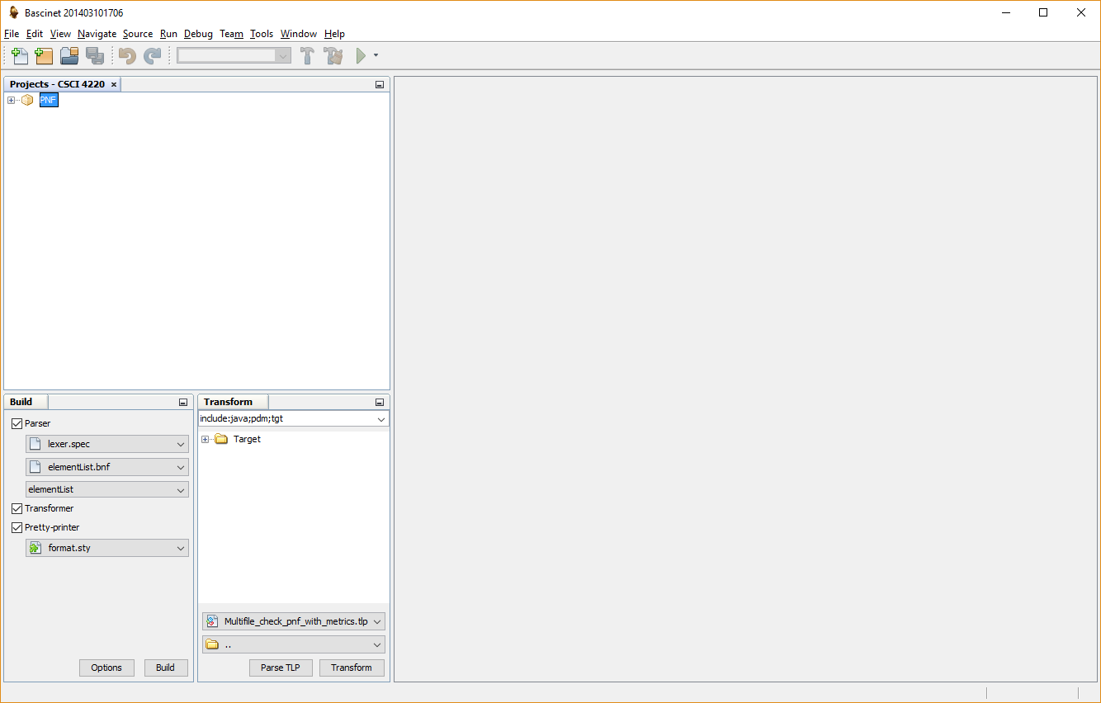
Left click on the project to select it.

Slide 22
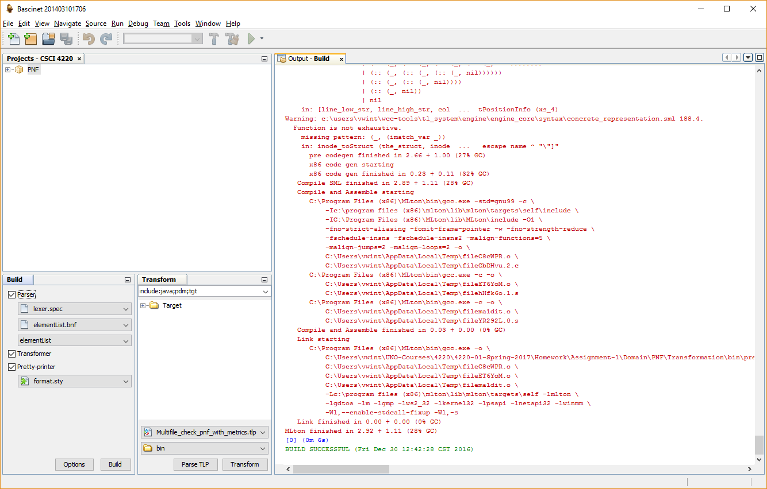
Left click to build the parser and the transformation engine.
If the build is successful, you will see this.

Slide 23
(RE)Building the engine
The transformation engine only needs to be (re)built in the following circumstances.
The grammar for the domain has changed - in which case you need to build a new parser.
The SML code used by the domain has changed – in which case you need to build a new transformer.
When to build the pretty-printer lies outside the scope of this course.

Slide 24
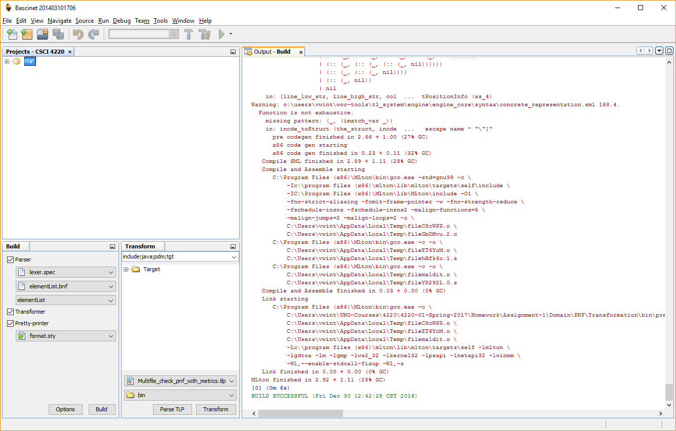

Slide 25
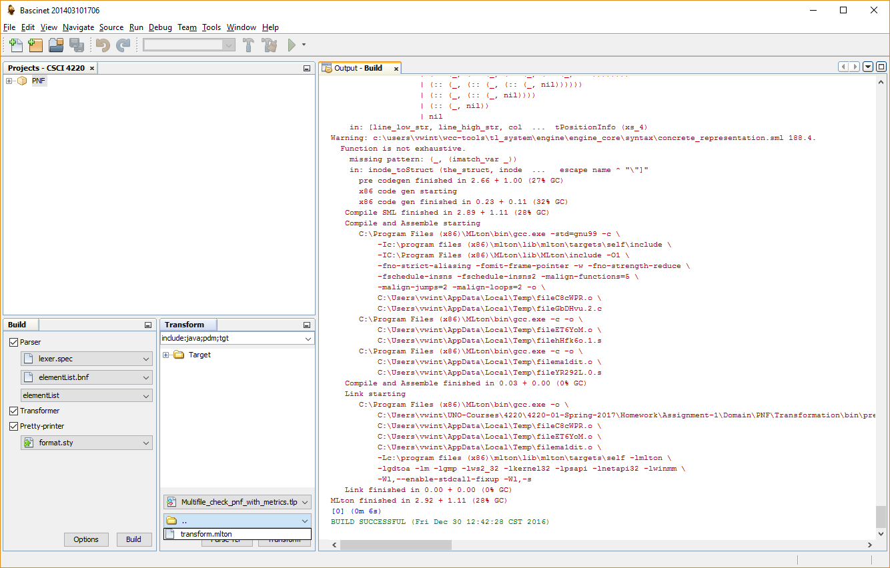
Select the transform.mlton file from the drop-down.

Slide 26
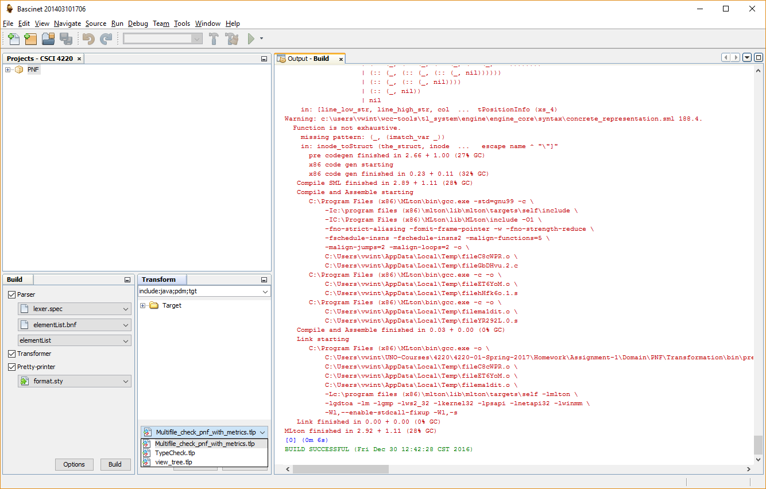
Select transformation file you want to use.

Slide 27
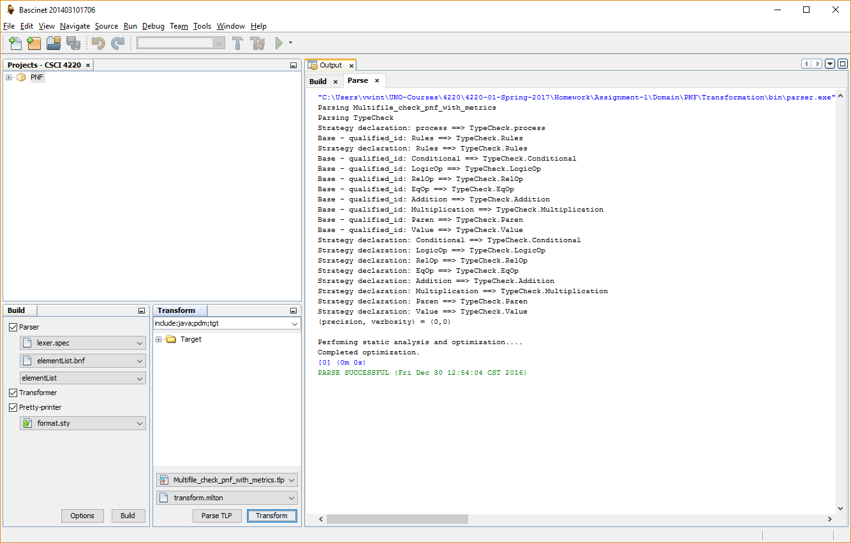
Parse/compile the selected transformation file.
If the parse goes well you will see this.

Slide 28
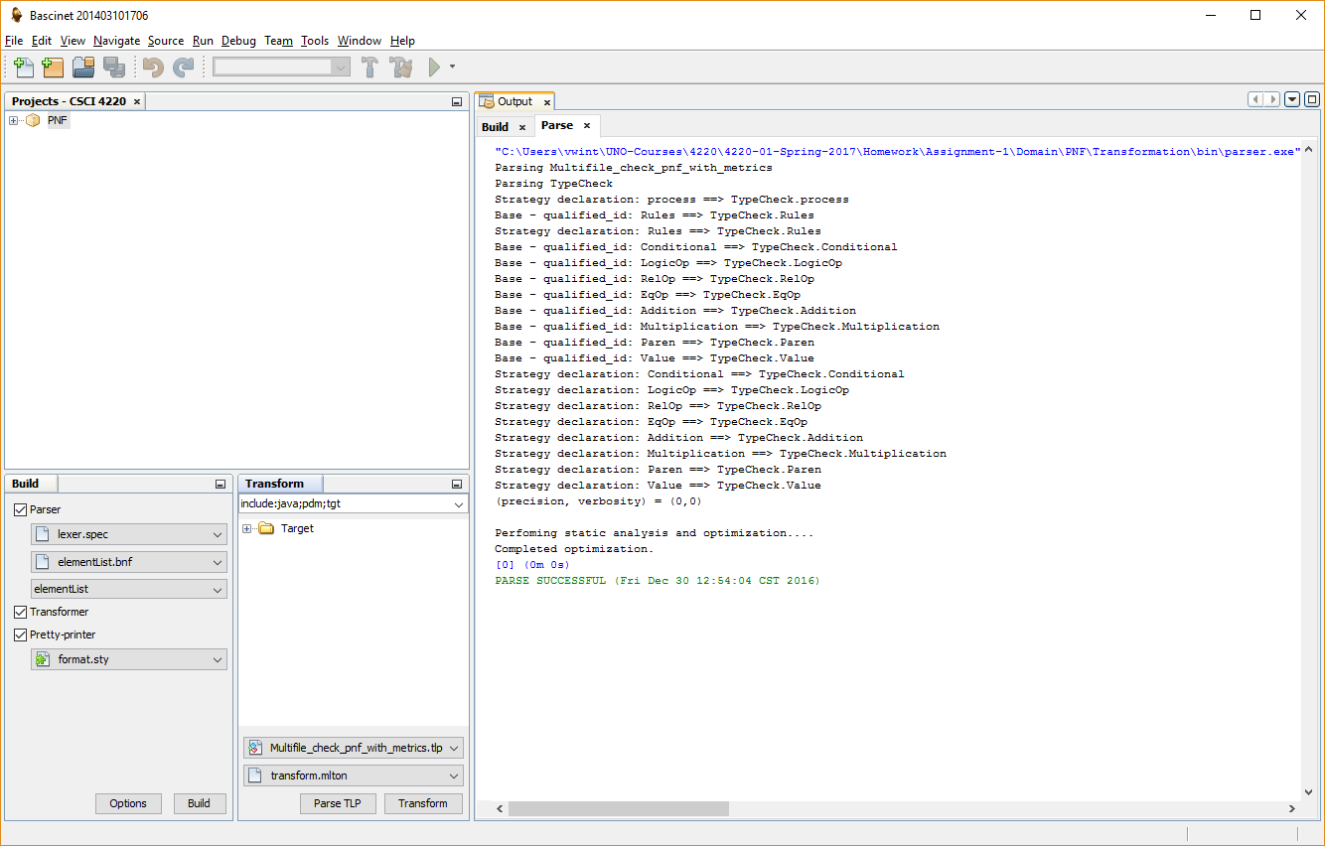
If needed, add tgt to this list

Slide 29
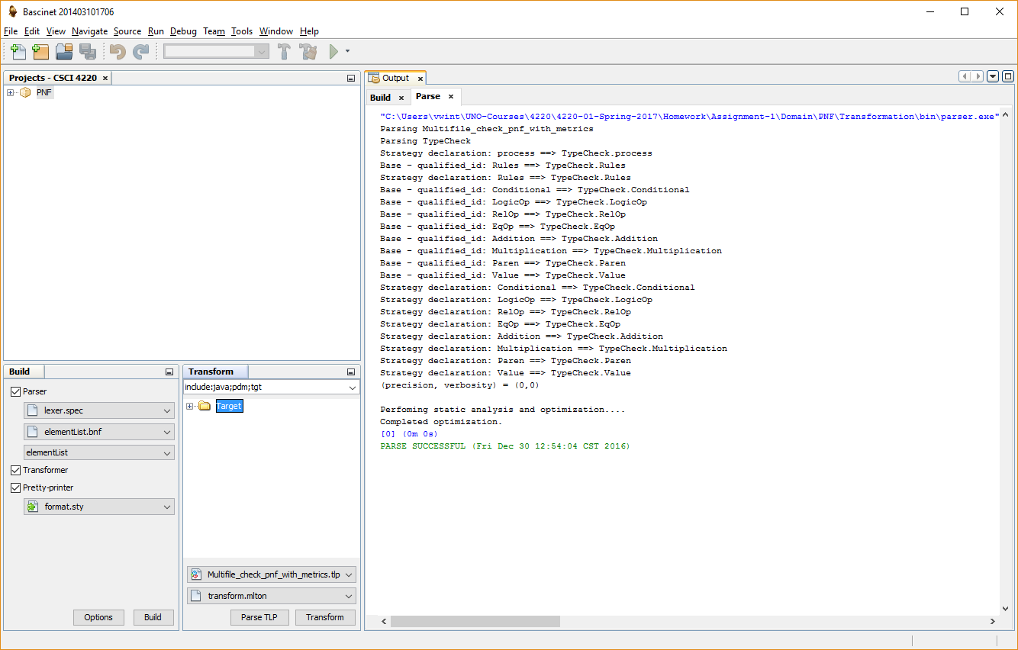
Left click to open

Slide 30
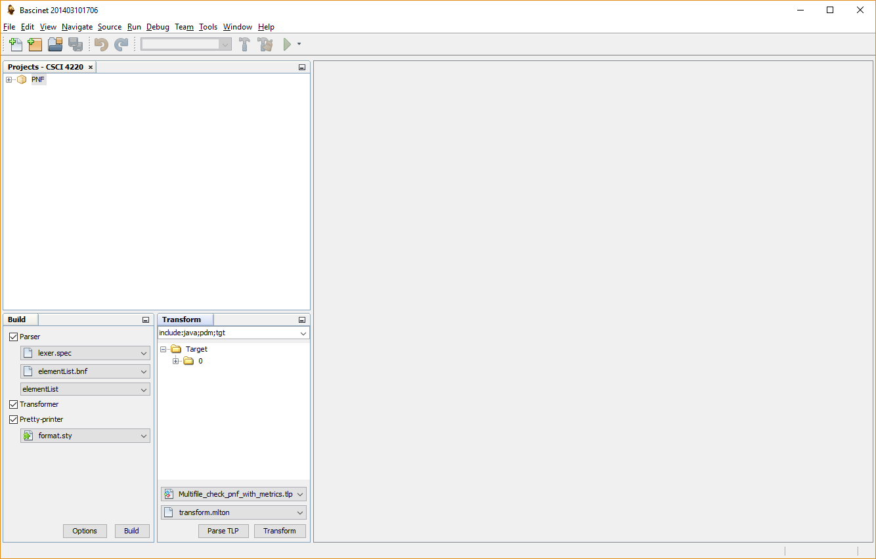
Left click to open

Slide 31
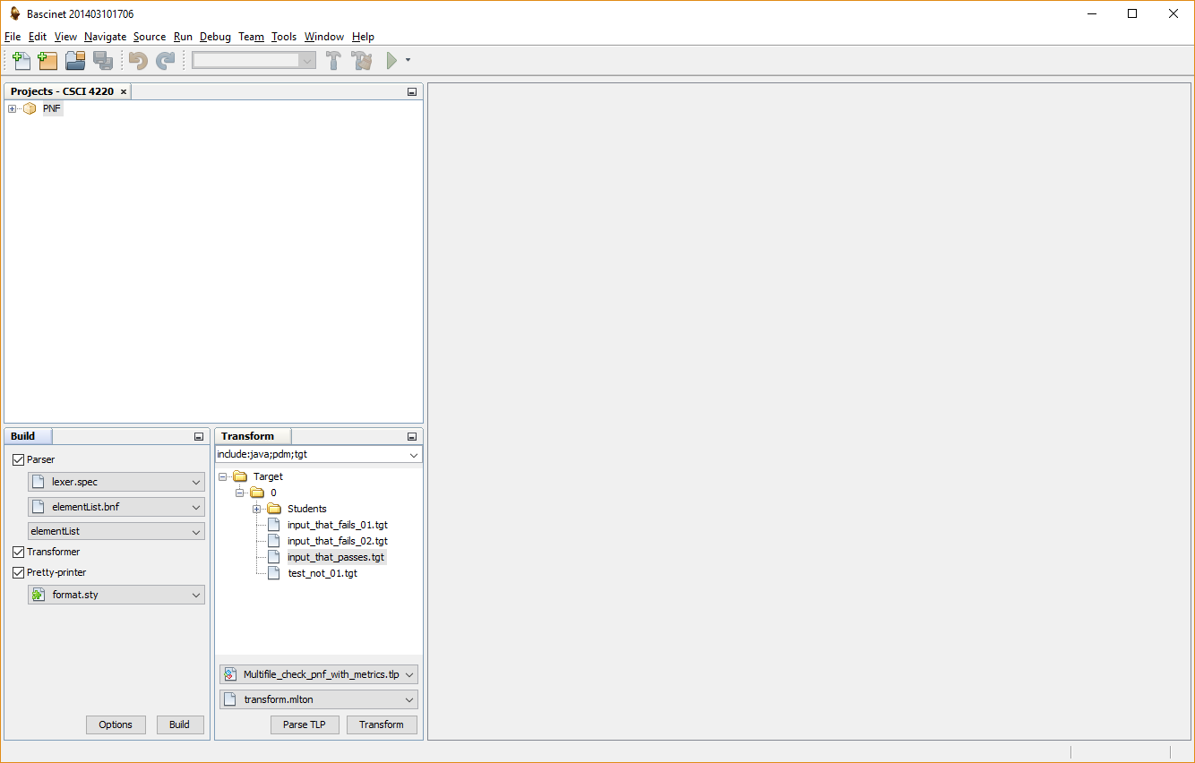
Select target file to transform.

Slide 32
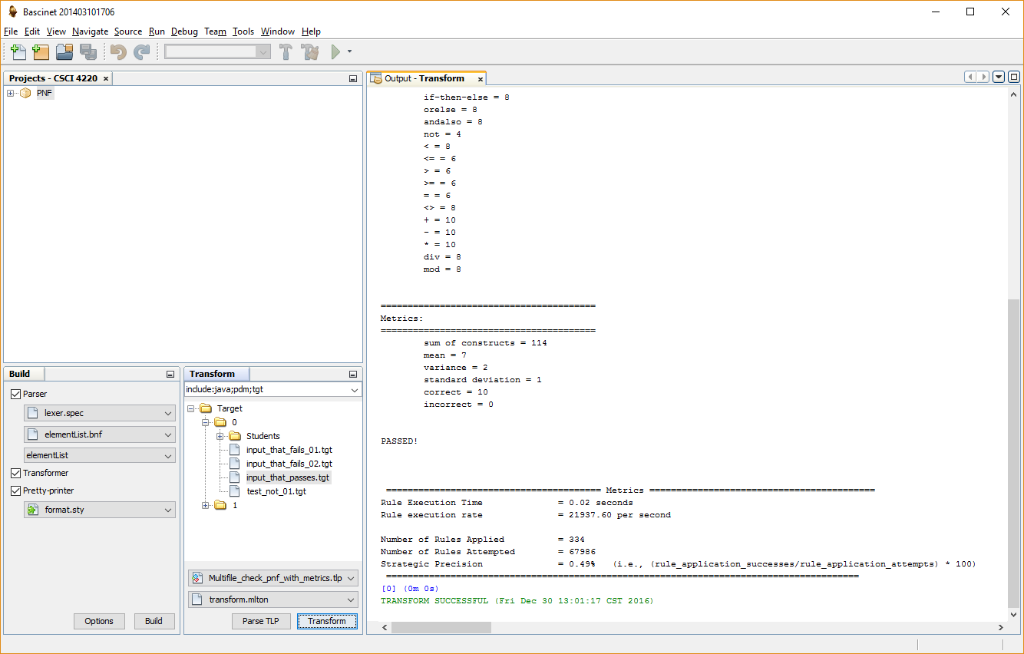
Output will be displayed
in this pane.
Transform the program.

Slide 33
The end

